Slide 1
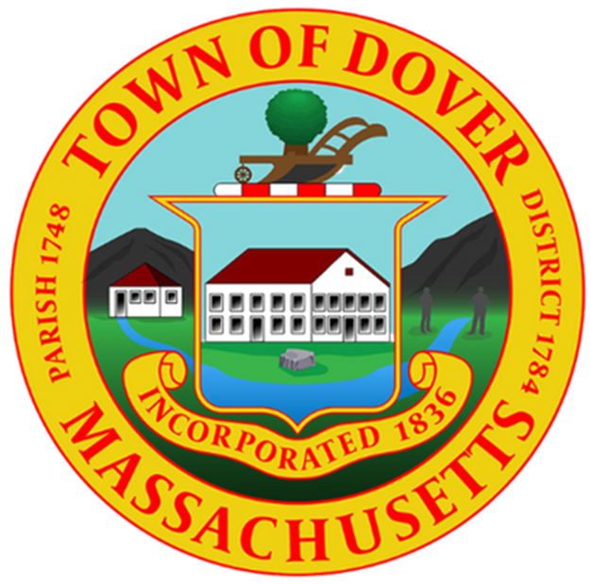
Article 17: Appropriate for One-Time Projects – Development and Housing Plan (Board of Selectmen)

Slide 2
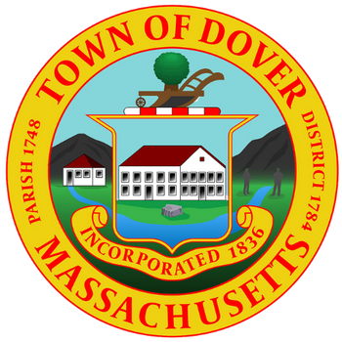

DOVER HOUSING TASK FORCE

Slide 3



DOVER HOUSING TASK FORCE – WHO ARE WE?
  The Dover Housing Task Force (DHTF) was formed by the Board of Selectmen in 2023
  Members include representatives (from staff & boards) from the Planning Board, Conservation Commission, Building Department & Board of Health
Our Mission:
Review Process
Communication
Tools
Provide Dover with a “Tool Box” for addressing multi-family developments that balance our goals of “open space and diversified housing stock”
Establish an internal Dover process for review of
multi-family developments
Establish a communication strategy and public education plan

Slide 4

Dover Housing Task Force
Special Warrant Article
  To establish a “Toolbox," the DHTF seeks to hire a consultant who can develop a comprehensive plan for Dover's development and housing.
  Requested Amount: $100,000
  Dover does not have the expertise in-house to address complex state laws

Slide 5

Why? Housing Challenges in Dover are Growing
  Chapter 40B/Affordable Housing applications are on the rise.
Developers are circling Dover (our much-loved open space is alluring)
  MBTA Communities Act compliance is mandatory by 12/31/25
(Milton illustrates the State’s commitment to this issue)
  We lack housing options for older adults, young adults, town employees, intergenerational families, etc.
  What kind of town do we want to call home in 5, 10, 20 years?
  (Do we want to decide or let developers and the State tell us?)

Slide 6

Two options: Proactive vs. Reactive Approach
  If we continue to act reactively, we lose control & funding
  Currently, we are vulnerable to a scenario called 40B Development, where state law overrules local regulations
  We do not currently have zoning in place that encourages the open space/smaller home development that many citizens desire

Slide 7

A Path Forward: Hire a Housing Consultant
  An independent consultant will help us develop a long-term housing vision and some options for Dover to consider in the future.
Deliverables:
  A comprehensive plan for development and housing in Dover through a community-wide engagement process (we control the decisions)
  The development of an MBTA Overlay District that keeps Dover in compliance with State law (we control where) while using local zoning to define many site and building-specific details
  Consider possible zoning by-law changes to meet the needs of Dover’s residents through local bylaws under local control

