Slide 1




Shrewsbury Comprehensive Master Plan Update
Master Plan Steering Committee
September 16, 2026

Slide 2

Introductions
Town of Shrewsbury
Planning and Economic Development Department
Christopher McGoldrick, Director
Louise O’Neill, Assistant Director
Consultant Team
Barrett Planning Group
Judi Barrett
Jennifer Doherty
Jill Slankas
Kimley-Horn
Lisa Juan, PE

Slide 3
Introductions
Master Plan Steering Committee
Planning Board | Stephan Rodolakis | ZBA | Fran Manella
School Committee | Nicole Torres | Student Rep.
Finance Committee | Vikram Chhabra | At-Large | Doug Muzzy
Select Board | Michelle Conlin | At-Large | Caroline Macomber
Select Board | Gregg Richards | At-Large | Leah Serafin Maroney
Historic District Commission |  | At-Large | Shannon Wall
Affordable Housing Trust | Beth Casavant | At-Large | Ken Griswold
Shrewsbury Dev. Corp. | Lee Abdella | Alternate | Lawrence Ondovic
Conservation Commission | Emily Petro | Alternate | Kathleen Flynn
Notes:
After introductions of the MPSC Members, take care of some procedural committee items including electing a chair and vice chair; and determining when public comments will be taken at each MPSC meeting, such as at the beginning or at the end.

Slide 4
Agenda
Icebreaker Activity
Master Plan Overview
Project Schedule
Project Website
Community Engagement Plan
Closing Activity

Slide 5
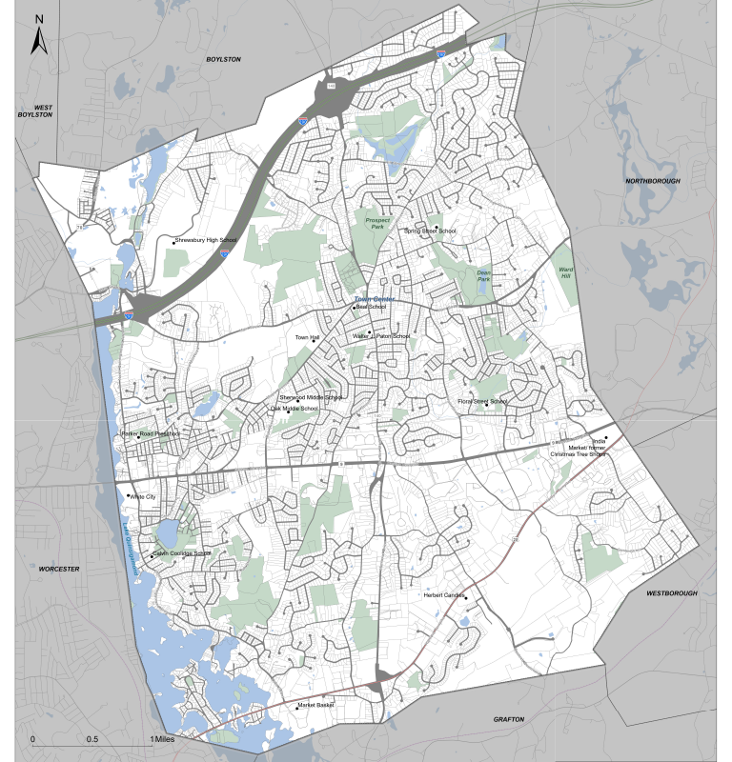
Icebreaker Activity
Imagine: A close friend is visiting our town for the first time. You have exactly 24 hours to show them the best of it.

Slide 6
Master Plan Committee Role
“Committee members will attend meetings, host public workshops, speak with residents about what they want to see in Shrewsbury’s future and work with subcommittees focused on specific areas of the Master Plan.”

Slide 7

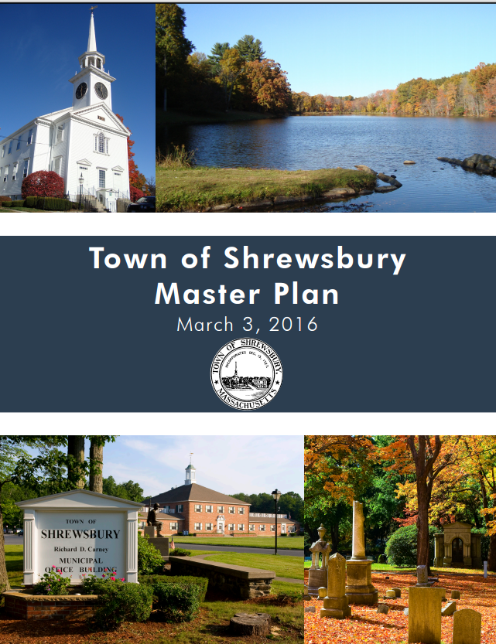

What is a Master Plan?
Update to 2016 Plan
A comprehensive, long-term plan that municipalities in Massachusetts are encouraged to adopt, as authorized under MGL c. 41 § 81D
High-level blueprint for what a community wants their town to look like in about 10 years and to guide decision-making
Planning process encourages community members to come together, hear each other’s voices, and hopefully come to some common understanding
Revisiting the plan periodically allows the Town to monitor progress and update as local conditions change

Slide 8
What is a Master Plan?
The process will consist of five broad phases:
Research and prepare an inventory and assessment of existing conditions for each element of the plan
Set a vision for the future
Identify key planning issues
Create goals and policies
Develop an implementation program to achieve the master plan’s goals
These broad phases often involve an iterative process of research, documentation, public engagement, assessment and reassessment, and decision-making.

Slide 9
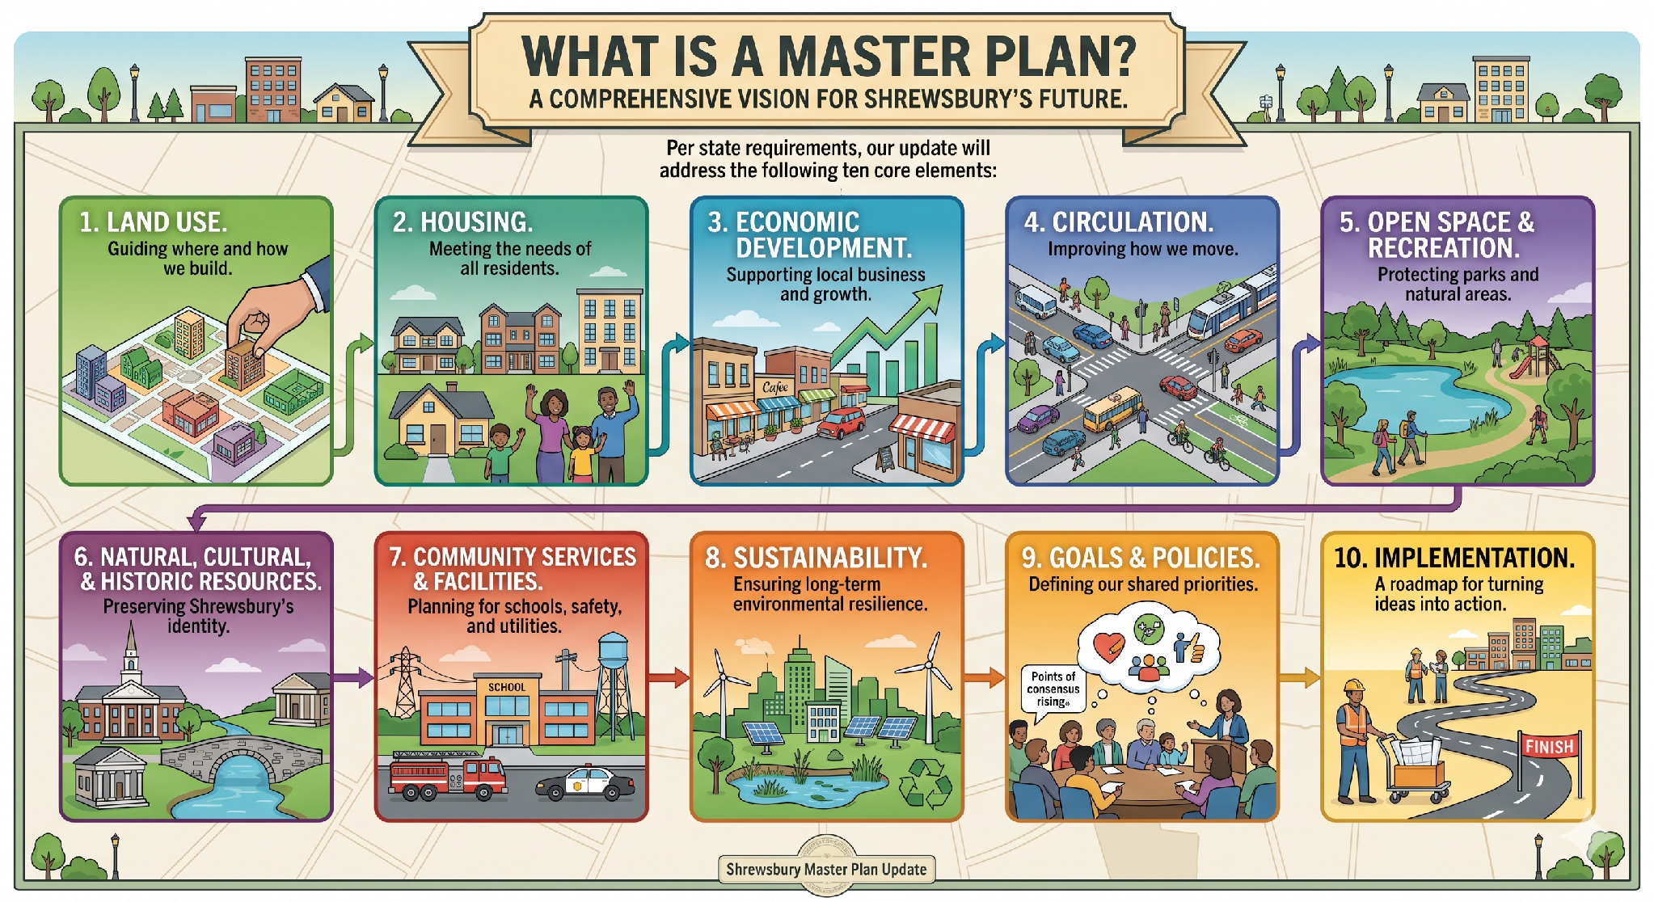
Master Plan Elements

Slide 10
Project Phases
Inventory & Assessment
In this early stage of the Master Plan, Shrewsbury’s existing conditions are assessed in several areas: Land Use, Housing, Economic Development, Natural Resources, Open Space and Recreation, Historic and Cultural Resources, Community Services and Facilities (including Sustainability), and Transportation. These are typical components of municipal master plans prepared today. State law requires most of them, but over time, local governments have added others, such as Sustainability, because these topics have become an important part of day-to-day municipal operations.

Slide 11
Past Planning Efforts
The Master Plan draws on information from many previous plans and studies undertaken for Shrewsbury and in the region.
Hazard Mitigation Plan (2026)
Economic Development Special Plan (2026)
Housing Production Plan (2024)
Open Space and Recreation Plan (2020)
2030 Strategic Action Plan (2022)
Municipal Climate Action and Resiliency Plan (2023)
… and many more

Slide 12
Project Phases
Set a Vision for the Future
A master plan vision articulates where a community wants to be in about 10-20 years. It states what the Town, guided by the contents of the master plan, is working towards. Relative to the other parts of a master plan, a vision is the policy direction, the goals for each master plan element are the policy framework, and the implementation plan is the roadmap for making that vision a reality.

Slide 13

2016 Community Vision
“
Our twenty-year vision for Shrewsbury is we will be a prosperous community, continuing to be one of the most attractive towns in the region for businesses and residents alike. Our neighborhoods will be beautiful and strong, providing good homes to residents of all backgrounds and ages, and children who live in Shrewsbury will continue to have access to the highest quality schools. Our local economy will be a diverse collection of businesses and industries across a wide range of sizes and sectors. These businesses will provide employment across many income levels, and they will be encouraged to explore innovation in both product development and business practice. Local government will play a critical supporting role for the everyday quality of life of our residents, the ability of our businesses to thrive, and the protection of the natural resources necessary to a healthy community.
”

Slide 14
Project Phases
Identify Key Planning Issues
The analysis of key issues flows out of the inventory and assessment process. The goal of this phase is to understand and bring focus to the Town’s most critical planning issues and needs. Some master plan topics may involve more pressing concerns than others. Sorting out what the priorities should be matters for managing resources and developing an implementation program that will be orderly, focused, and effective.

Slide 15
Project Phases
Create Goals and Policies
Understanding key issues will help to set Shrewsbury’s Master Plan goals and priorities for the future.
Develop an Implementation Plan
To achieve the identified goals, Town Staff and the Master Plan Steering Committee will develop an implementation program for Shrewsbury to follow. This helps to ensure the future Shrewsbury envisions for itself is accessible and achievable.

Slide 16

Project Schedule
Getting Started
(May-Jun ’26)
Inventory and Assessment
(Jul-Sep ’26)
Key Issues & Opportunities
(Oct-Dec ’26)
Goals
(Jan-Feb ‘26)
Implementation Plan
(Mar-Apr ’27)
Final Plan
(May ’27)
Workshop #1: Discovery & Visioning
Workshop #3:
Advancing Goals to Strategies
Workshop #2:
Sharing Inventory Findings & Vision & Goals
* Dates shown are preliminary and may be revised as the master planning process progresses.

Slide 17
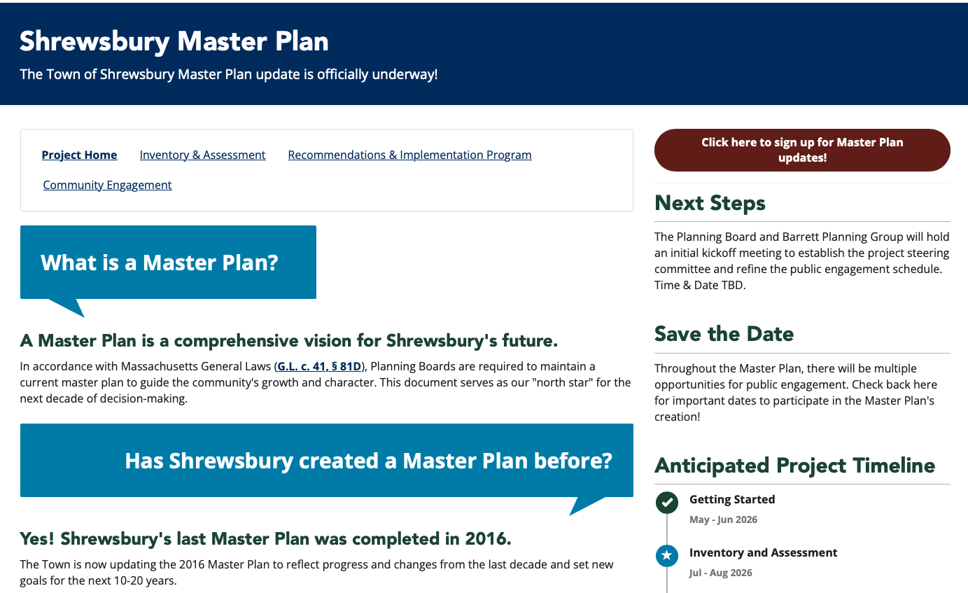

Project Website
bpg.mysocialpinpoint.com/
shrewsbury-master-plan

Slide 18

Community Engagement Plan
Project Website and Updates
Short Surveys
Tabling at Community Events
Stakeholder Interviews
Community Forums (2-3)
Final Presentation of Plan
Notes:
Note Spirit of Shrewsbury and list of other activities happening throughout town

Slide 19
Activities
Community Connections
Question of the Month

Slide 20
Community Connections
NAME | MPSC REP. | GROUPS AND ORGANIZATIONS - CONNECTIONS
Stephan Rodolakis | Planning Board
Nicole Torres | School Committee
Vikram Chhabra | Finance Committee
Michelle Conlin | Select Board
Gregg Richards | Select Board
 | Historic District Commission
Beth Casavant | Affordable Housing Trust
Lee Abdella | Shrewsbury Dev. Corp.
Emily Petro | Conservation Commission
Fran Manella | Zoning Board of Appeals
 | Student Rep.
Doug Muzzy | Member At Large
Caroline Macomber | Member At Large
Leah Serafin Maroney | Member At Large
Shannon Wall | Member At Large
Ken Griswold | Member At Large
Lawrence Ondovic | Alternate - Member At Large
Kathleen Flynn | Alternate - Member At Large
Notes:
After this activity and before the closing activity, discuss day and time that generally works well each month for MPSC meetings.

Slide 21
Closing Activity:
Question of the Month
In five words or less what would you like the Master Plan to address?
____________________________
Scan the QR Code to answer the Question on the project webpage

Slide 22
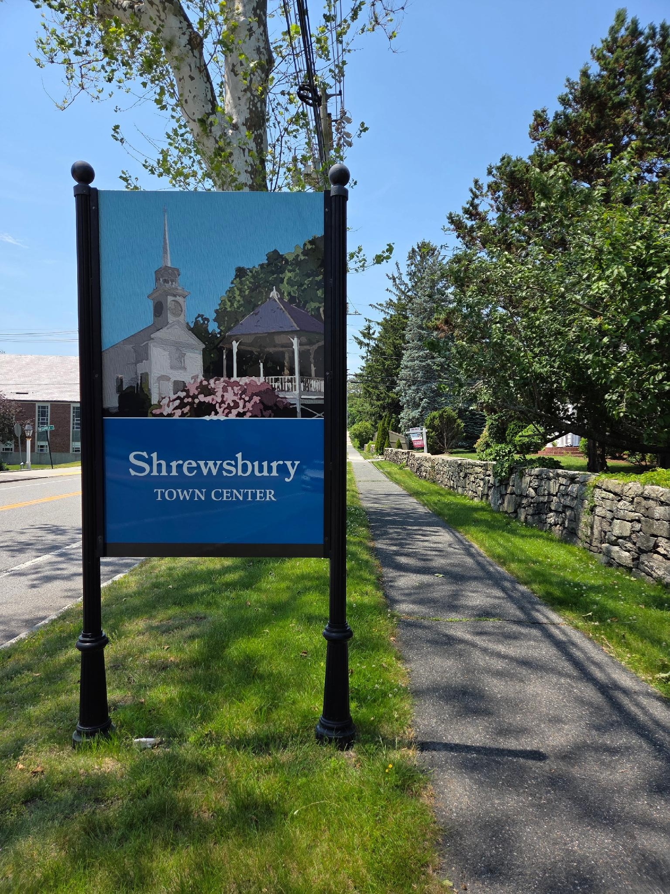
Set Next Meeting Date

