Slide 1




Shrewsbury Comprehensive Master Plan Update
Master Plan Steering Committee Meeting
October 14, 2026

Slide 2
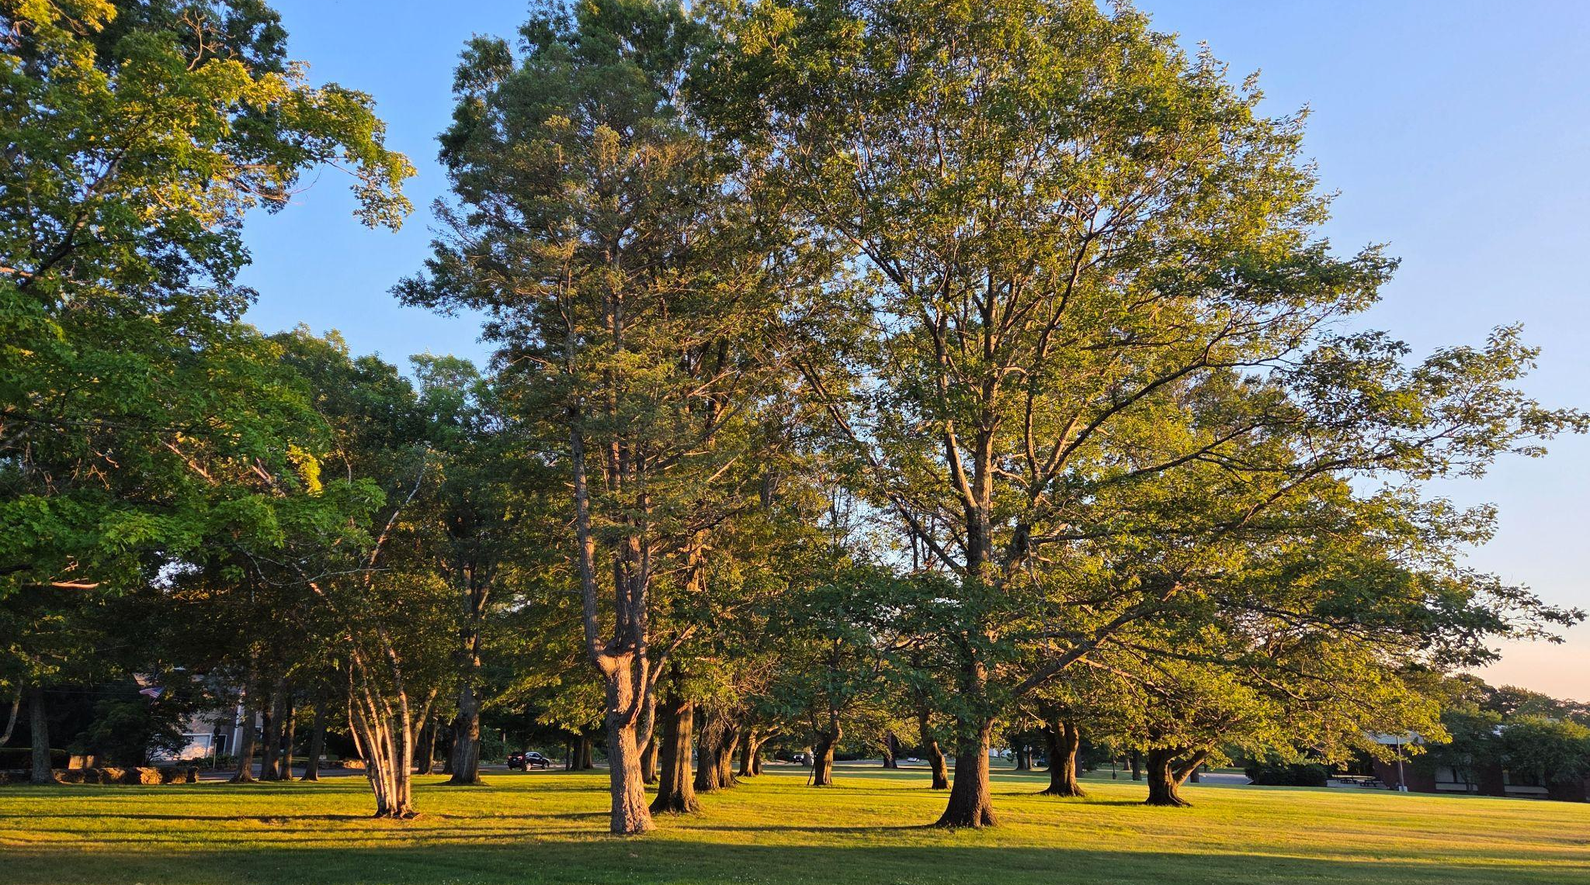
Welcome!

Slide 3

Introductions
Town of Shrewsbury
Planning and Economic Development Department
Christopher McGoldrick, Director
Louise O’Neill, Assistant Director
Consultant Team
Barrett Planning Group
Judi Barrett
Jill Slankas
Laurel Mire
Kimley-Horn
Lisa Juan, PE

Slide 4
Introductions
Master Plan Steering Committee
Planning Board | Stephan Rodolakis | ZBA | Fran Manella
School Committee | Nicole Torres | Student Rep. | Teja Mamidala
Finance Committee | Vikram Chhabra | At-Large | Doug Muzzy
Select Board | Michelle Conlin | At-Large | Caroline Macomber
Select Board | Gregg Richards | At-Large | Leah Serafin Maroney
Historic District Commission | Kris Gustafson | At-Large | Shannon Wall
Affordable Housing Trust | Beth Casavant | At-Large | Ken Griswold
Shrewsbury Dev. Corp. | Lee Abdella | Alternate | Lawrence Ondovic
Conservation Commission | Emily Petro | Alternate | Kathleen Flynn
Notes:
Ask Chris if we can go around the room and have everyone introduce themselves as we have two new members joining us tonight.

Slide 5
Agenda
Engagement Updates
Inventory & Assessment Highlights
Visioning Activity
Next Meeting
Notes:
Tonight’s agenda will cover some community engagement updates on what has been done to date and what is coming up next;
We will also share some highlights on the existing conditions pertaining to each element of the master plan;
After listening to that part of the presentation, we will do a visioning activity; and somewhere in the meeting tonight we'll set the master plan steering committee schedule for the upcoming months.

Slide 6
COMMUNITY ENGAGEMENT UPDATES
What’s been done
Interviews with Town Staff
Short Survey of Town Boards and Committees
Question of the Month #1
24-Hours in Shrewsbury Map Challenge Icebreaker
Project Webpage Updates
Spirit of Shrewsbury
Notes:
As part of the background information gathering phase of the Comprehensive Master Plan update, the consultant team of Barrett Planning Group and Kimley-Horn conducted virtual interviews with Town staff in July 2026. These virtual 1 hour sessions gathered local knowledge and perspectives on current conditions, recent changes, and emerging issues in Shrewsbury.
Also as part of this information gathering phase, a short survey was developed and distributed to town boards and committees to provide input. In total, 21 members completed the survey representing 15 boards and committees. The short survey asked what members considered the board or committees major accomplishments over the past ten years, how has their work changed, what are the plans for the next ten years, how do they interact with the current (2016) master plan, and how is their area of work perceived by the Town administration? The general public? And if they have any issues getting things done?
We would like to thank everyone who took the time to share their insight with us.
Question of the Month - every month we will post a new question on the Master Plan website to collect public input throughout the Master Plan process. Previous month’s questions will remain on the project webpage and left open for new responses in case community members miss a month or begin contributing later on in the planning process. The September question of the Month was “In five words or less, what do you want the Master Plan to address?” This question has received 57 responses to date and a summary of those responses will be available on the project webpage.
Also, a summary of the 24 Hours in Shrewsbury Map Challenge that the MPSC members participated in at the last meeting will be available on the project webpage. This was the icebreaker activity that imagined that you had 24 hours to show a friend the best of Shrewsbury and asked where you would take them and why those places were special.
Project webpage updates - presentation slides from the last MPSC meeting.
Spirit of Shrewsbury - (Lisa to give a report on) … Approximately 75-100 people showed up at the table and engaged with Lisa and John from Kimley-Horn throughout the day; about 50 people engaged with the mapping activity and placed stickers. The table area had a large map of Shrewsbury and asked people to “place a sticker at locations of interest or concern”. The summary of comments from this event will also be available on the project webpage.

Slide 7
COMMUNITY ENGAGEMENT UPDATES
What’s next
Question of the Month #2
Project Webpage Updates
Community Forum - Discovery & Visioning
Notes:
October Question of the Month - Tell us what you value about Shrewsbury and what you hope will remain part of the community as it grows and changes. This could be a place, a tradition, a service, a natural resource, a community quality, or something else that matters to you.
What makes Shrewsbury special today, and what should we protect for the future?
Homework → think about and answer this question in the next few days
Project webpage updates - the summaries I just mentioned of interviews, short survey, September QoM, Shrewsbury Map Challenge Activity, as well as presentation slides from tonight’s meeting.
Community Forum - Discovery and Visioning
Set date and time
* So now you have a sense of what has been done so far for outreach and engagement and some things that are in the works. Think about other ways and places that you as committee members might like to go in the community to listen to people and get feedback to help inform the master plan. The consultant team along with town staff can help support your efforts with developing materials as needed.

Slide 8


INVENTORY & ASSESSMENT
Overview
In this early stage of the Master Plan, Shrewsbury’s existing conditions are assessed in several areas: Land Use, Housing, Economic Development, Natural Resources, Open Space and Recreation, Historic and Cultural Resources, Community Services and Facilities (including Sustainability), and Transportation. These are typical components of municipal master plans prepared today.
Items marked with this symbol are recommendations from the 2016 Master Plan
Notes:
We have prepared an overview of each element of the master plan highlighting a relevant data point or an action item that has been achieved since the 2016 plan. These lists are just to get you acquainted with some of the information in the inventory and assessment and is by no means exhaustive of all that will be contained in the report. The items noted with the symbol of a clipboard with a checklist on it, are recommendations from the 2016 Master Plan.

Slide 9
INVENTORY & ASSESSMENT
Natural Resources and Open Space and Recreation
Established a stormwater utility fee to provide dedicated funding for stormwater management
Acquired parcels in the area of the former Grafton State Hospital adjacent to/in a Zone II aquifer recharge area
Implemented several efforts to manage invasive species including development of a recommended planting guide and hosting regular water chestnut pulls
Notes:
A stormwater utility was established in 2019
In 2018, the Town purchased several large parcels belonging to Grafton State Hospital to use for agricultural preservation, open space, and active and passive recreation.
Provided continuing education for municipal staff about the identification, management, and removal of invasive plant species including a recommended planting guide developed in 2023; hosting events targeted at the removal of water chestnut;

Slide 10
INVENTORY & ASSESSMENT
Natural Resources and Open Space and Recreation (cont’d)
Declaration that the Asian Longhorn Beetle has been eradicated from town in September, 2026
Applied to and received state, federal and non-profit grants to preserve, protect, and enhance open space parcels
Notes:
and the declaration that the Asian Longhorn Beetle has been eradicated from Shrewsbury as of September 2026. (by DCR, MDAR and _____)
Applied to and received state, federal and non-profit grants to preserve, protect, and enhance open space parcels - this included a $50,000 MassTrails grant to expand the trail around Jordan Pond (2022); $27,000 Local Hazard Mitigation Plan Planning Grant from FEMA (2025); $100,000 MVP 2.0 grant from ResilientMass (2026)

Slide 11
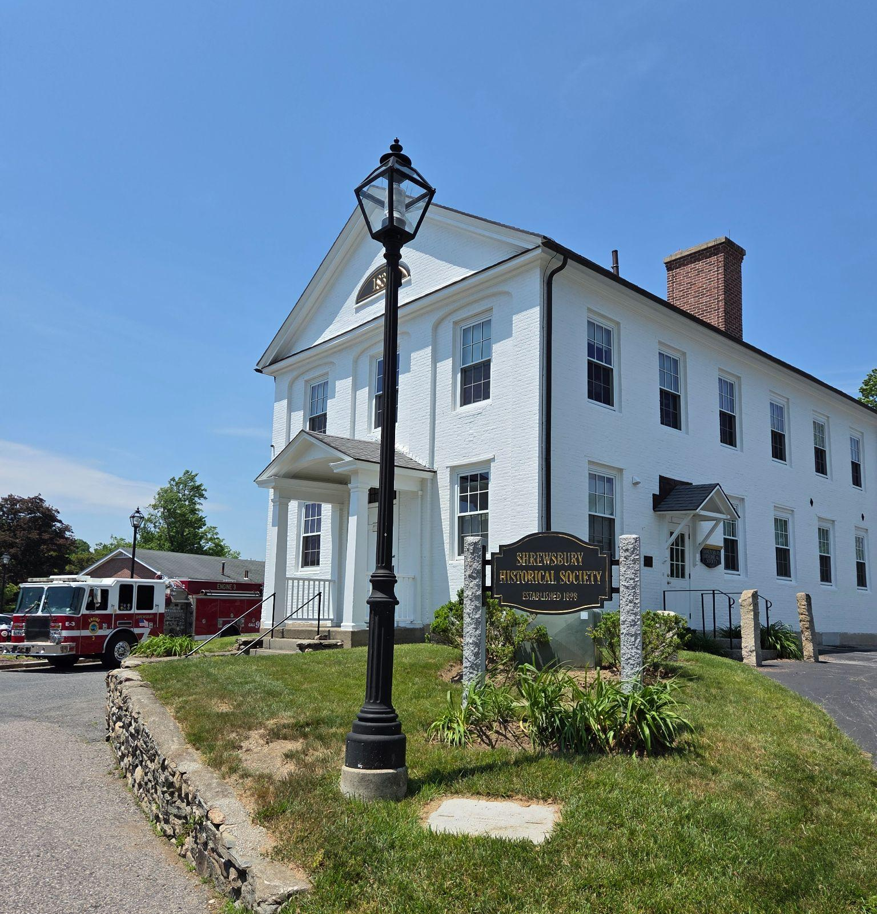
INVENTORY & ASSESSMENT
Historic and Cultural
Resources
Adopted the Community Preservation Act
Opened a newly-expanded Shrewsbury Public Library, providing more space to meet the changing library needs of the community
No additional historic preservation protections
have been adopted, nor have any additional historic resources been added to the Massachusetts Historical Commission’s statewide database of historic resources
Notes:
Adopted the Community Preservation Act (2020)
Opened a newly-expanded Shrewsbury Public Library, providing more space to meet the changing library needs of the community
No additional historic preservation protections have been adopted, nor have any additional historic resources been added to the Massachusetts Historical Commission’s statewide database of historic resources

Slide 12
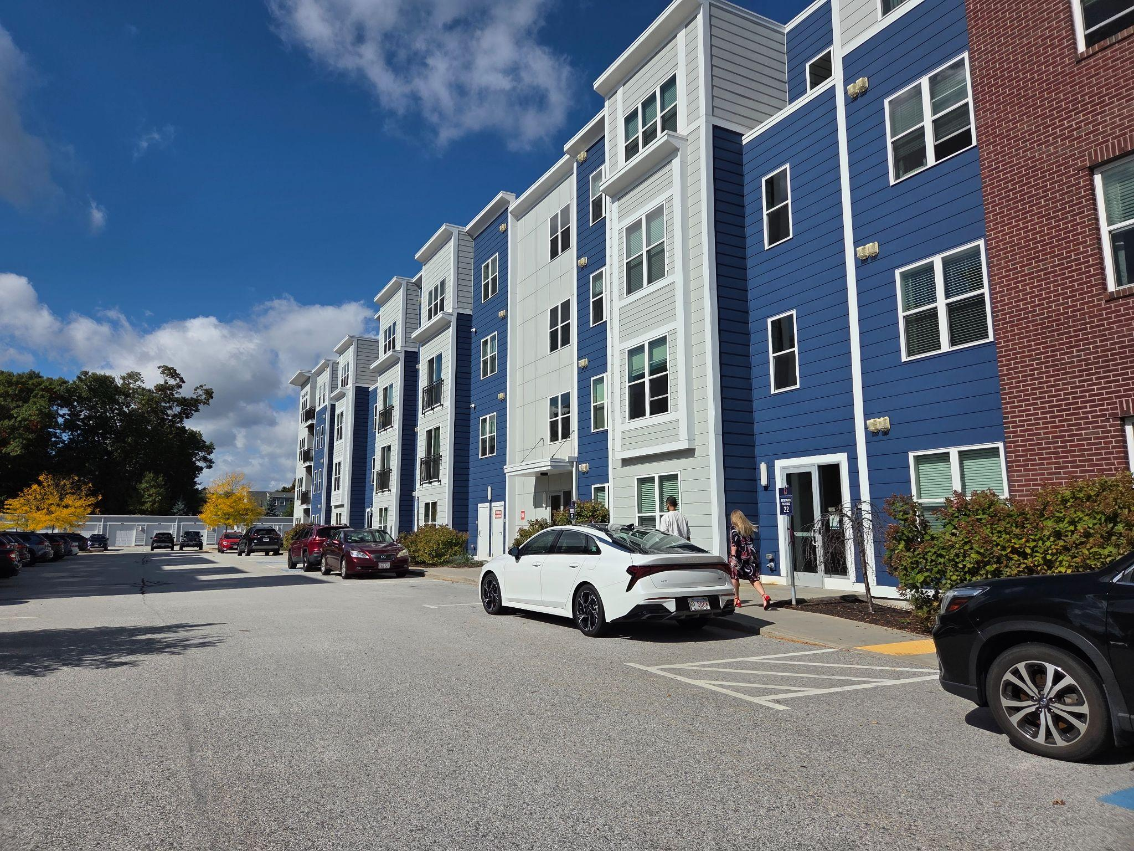
INVENTORY & ASSESSMENT
Housing
New developments provide a variety of housing options to residents
Established an Affordable Housing Trust to fund and develop affordable housing
Amended the accessory dwelling unit bylaw to comply with new state regulations
The inclusionary zoning bylaw has not been updated
Senior housing continues to be a concern among residents
Notes:
New developments provide a variety of housing options to residents
Established an Affordable Housing Trust to fund and develop affordable housing (2021)*
Amended the accessory dwelling unit bylaw to comply with new state regulations
The inclusionary zoning bylaw has not been updated*
Senior housing continues to be a concern among residents*

Slide 13
INVENTORY & ASSESSMENT
Land Use
Satisfied the requirements of the new MBTA Communities law
Several major sites were redeveloped including Spag’s and the Edgemere drive-in
Increased development led to resident concerns about infrastructure impacts and a two-year moratorium on the Lakeway and Route 20 overlay districts
Notes:
Satisfied the requirements of the new MBTA Communities law
Several major sites were redeveloped including Spag’s and the Edgemere drive-in
Increased development led to resident concerns about infrastructure impacts and a two-year moratorium on the Lakeway and Route 20 overlay districts

Slide 14
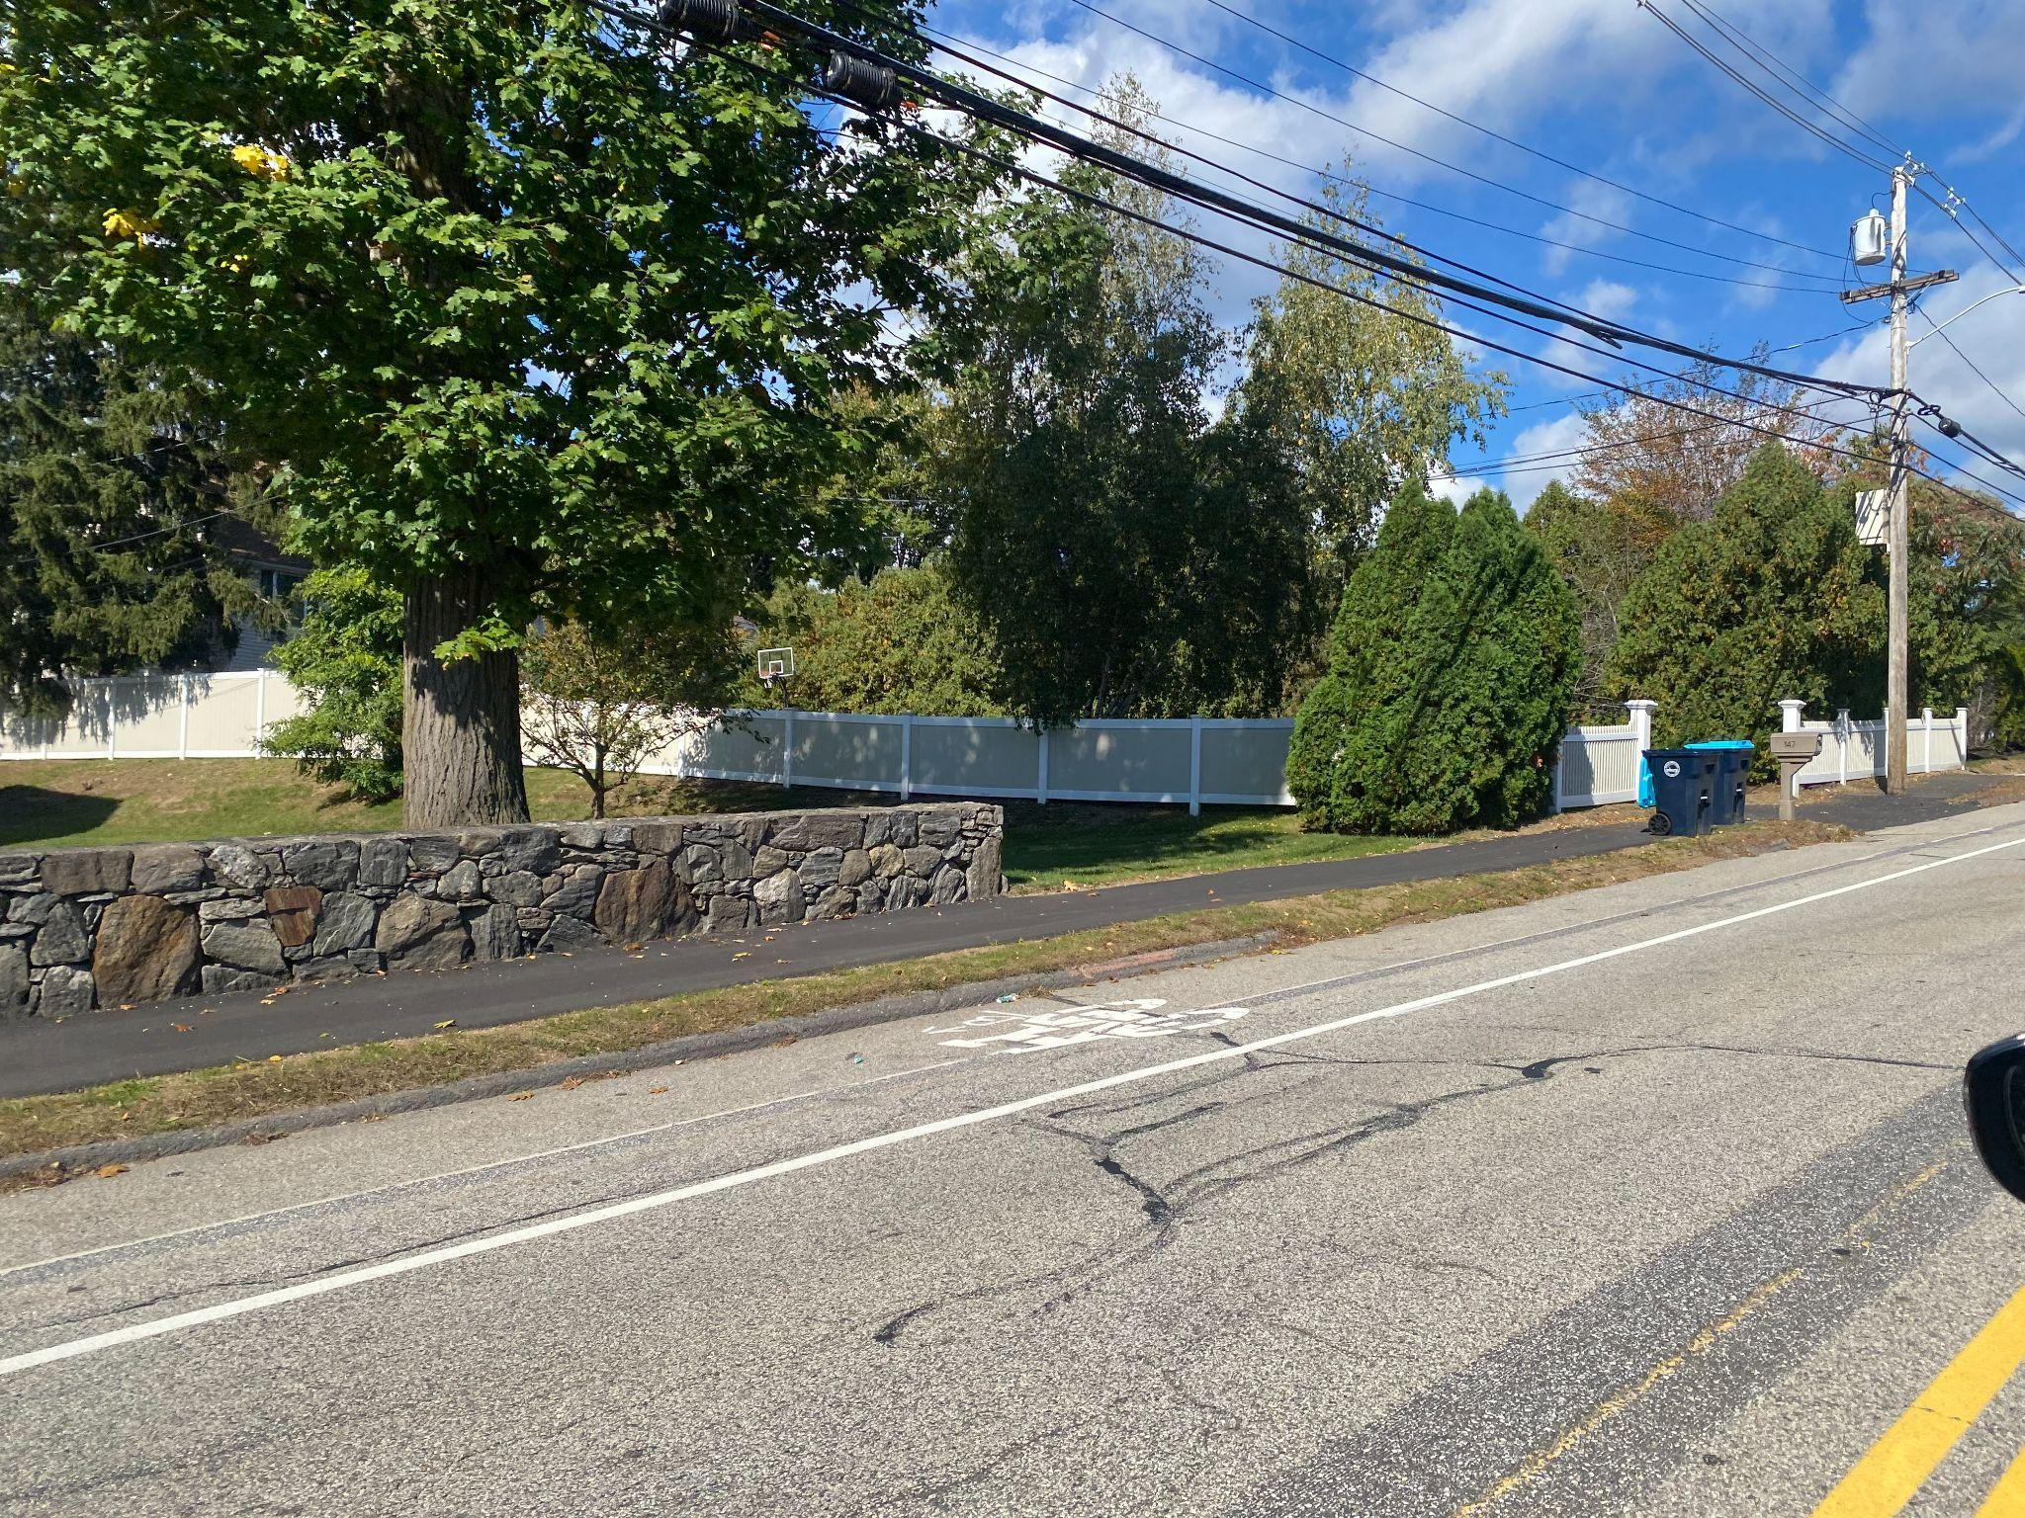
INVENTORY & ASSESSMENT
Transportation and Circulation
Following the completion of a Route 20 Corridor Master Plan Study, roadway improvements have received TIP funding
A Complete Streets Grant supported the installation of sidewalks, curb ramps, crosswalks, and bike lanes along North Quinsigamond Avenue

Slide 15
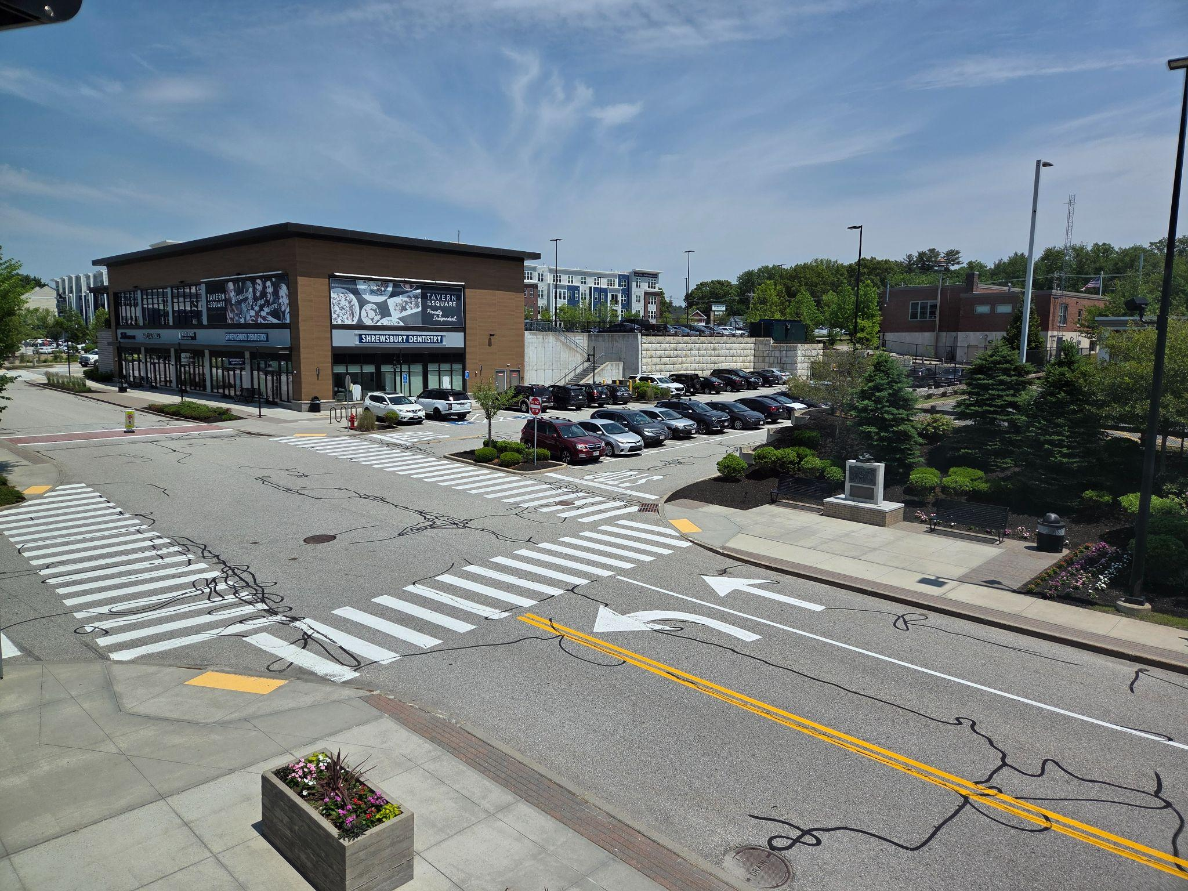
INVENTORY & ASSESSMENT
Transportation and
Circulation
The Shrewsbury Police Department and Safe Routes to School efforts support safe travel education for elementary school students
WRTA fixed-route service has not expanded but new microtransit and paratransit options offer more ways to get around
Gaps in the sidewalk network continue to be a major concern among residents

Slide 16
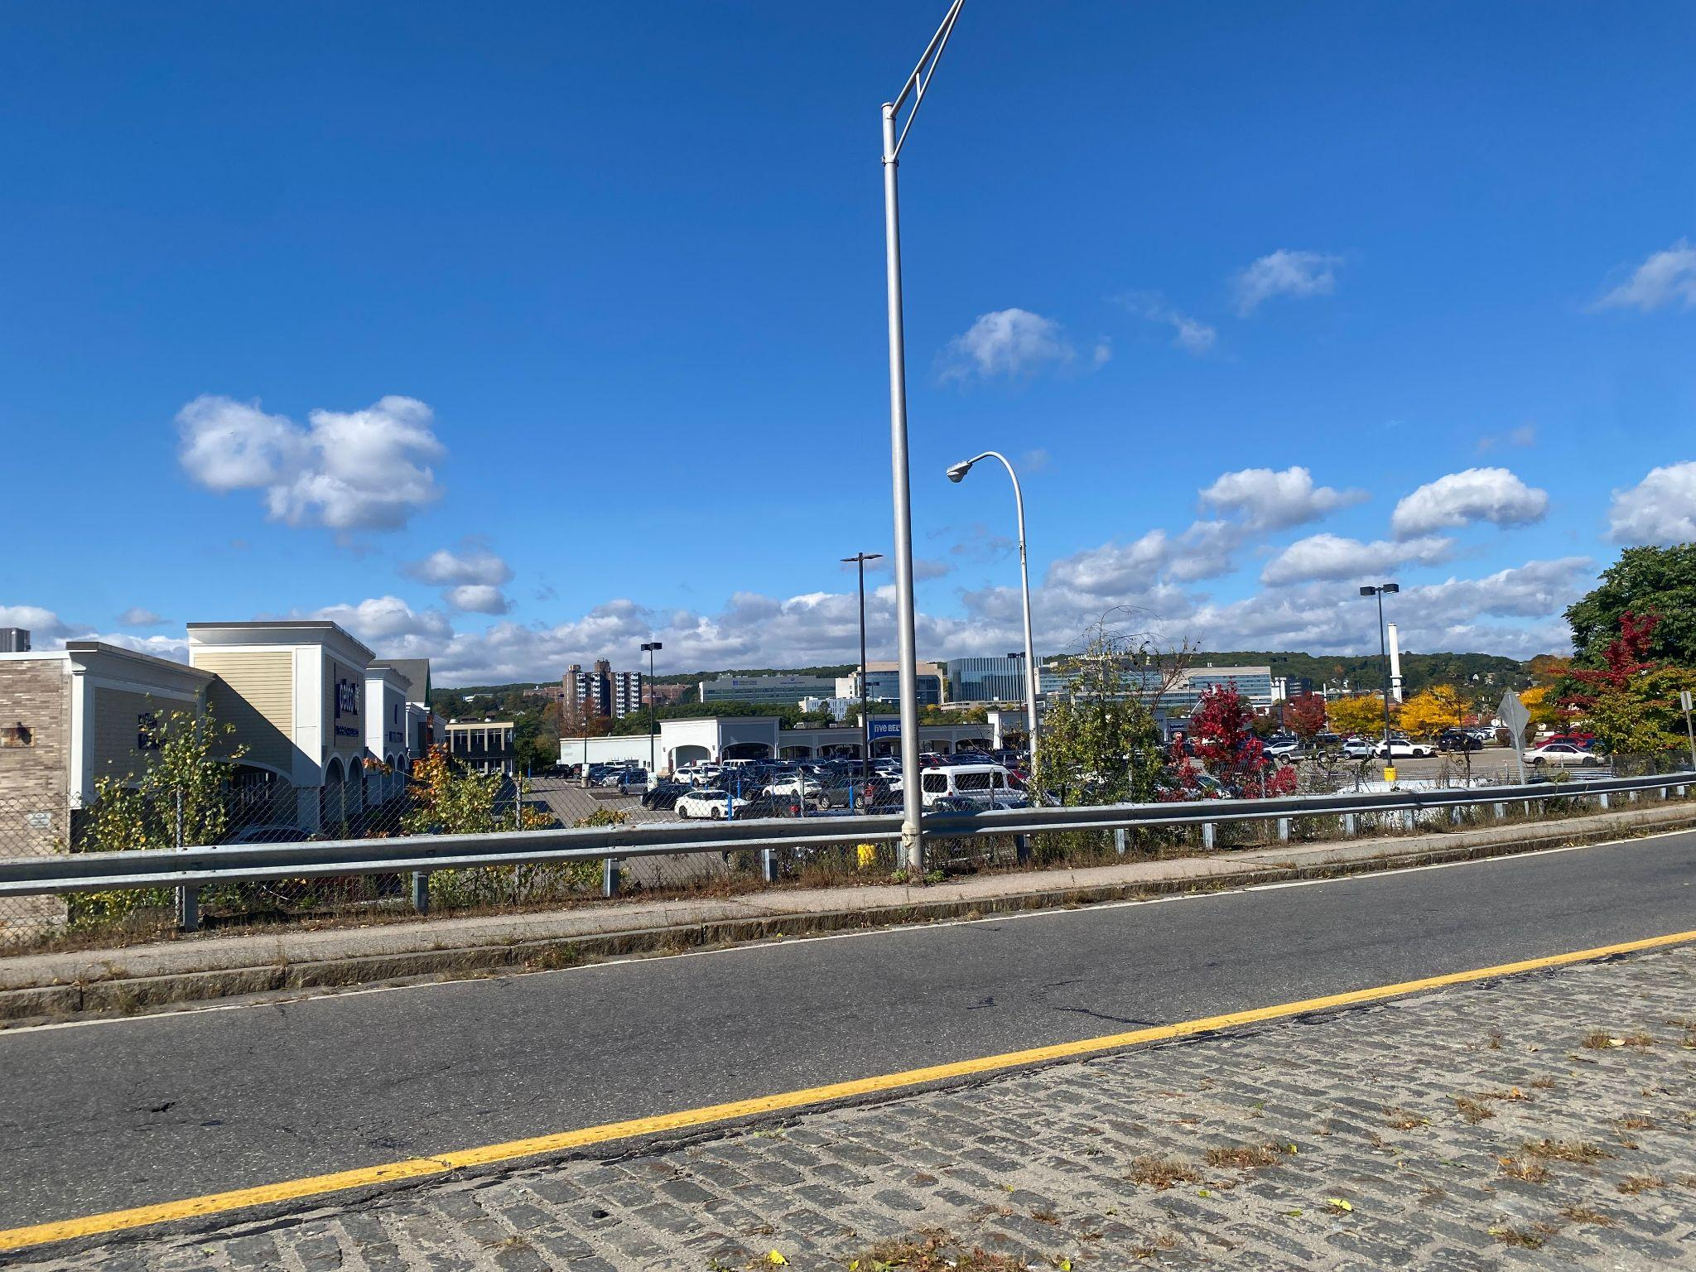
INVENTORY & ASSESSMENT
Economic Development
Sewer expansion projects, particularly along Route 20, have supported development efforts
Post-pandemic job growth has focused on the Educational Services, Accommodation and Food Services, Retail, and Construction industries
Several programs have focused on revitalization at the Town Center
Recently completed a town-wide economic development plan and have reactivated the Shrewsbury Development Corporation
Notes:
Over the past decade, the Town has devoted considerable capital funds to sewer expansion projects along route 20, opening up the area for commercial, industrial, and residential development.
The pandemic marked a shift in what industries were growing in Shrewsbury. Before the pandemic, most job growth occurred in Health Care and Social Assistance. However, post-pandemic job growth was led by Educational Services, Accommodation and Food Services, Retail, and Construction.
Shrewsbury’s 2016 Master Plan prioritized strengthening and enhancing the Town Center. This priority resulted in ongoing Town Center Revitalization efforts including several projects such as Town Center visioning, a parking study, creation of a Town Center Zoning District, public-private partnerships to redevelop 1-7 Maple Ave, updated wayfinding and branding, and a multimodal transportation study.

Slide 17
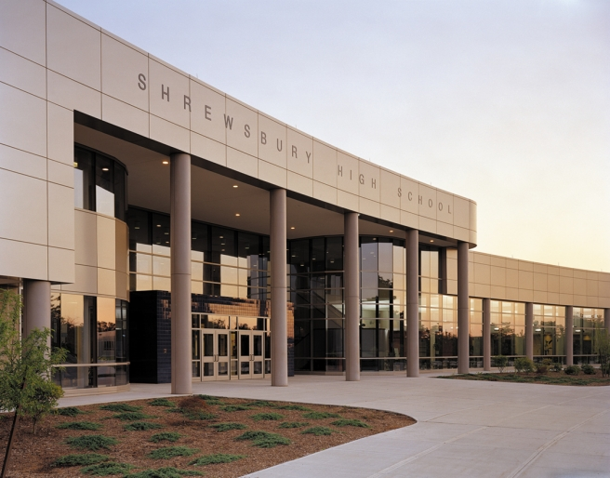
INVENTORY & ASSESSMENT
Community Facilities and Services
Several drinking and wastewater infrastructure projects have expanded the Town’s capacity and ability to meet new federal standards
Growing municipal office and space needs continue to strain the Town’s current buildings
Shrewsbury Public Schools continue to draw
residents, but concerns are ongoing about
declining enrollment, building conditions, and capacity
Adopted the All In Shrewsbury Municipal Climate Action and Resiliency Plan (MCARP) to support municipal sustainability efforts

Slide 18
INVENTORY & ASSESSMENT
Community Facilities and Services
Table C-1. SPS Capacity and Enrollment (10-1-2025)
School | Building Design Capacity | Student Enrollment
Preschool | 242 (based on mostly half day programs) | 179
Major Howard W. Beal School (Grades K-4) | 790 | 637
Calvin Coolidge School (Grades K-4) | 414 (includes 4 modular classrooms) | 292
Walter J. Paton School (Grades K-4) | 368 (includes 3 modular classrooms) | 265
Spring Street School (Grades K-4) | 368 (includes 6 modular classrooms) | 306
Floral Street School (Grades 1-4) | 660 | 489
Sherwood Middle School (Grades 5-6) | 900 | 891
Oak Middle School (Grades 7-8) | 900 | 909
Shrewsbury High School (Grades 9-12) | 1,475 | 1,899
Source: Town of Shrewsbury, 2025 Annual Town Report
Notes:
overall enrollment and Oak Middle School and Shrewsbury High School exceeding building design capacity.

Slide 19
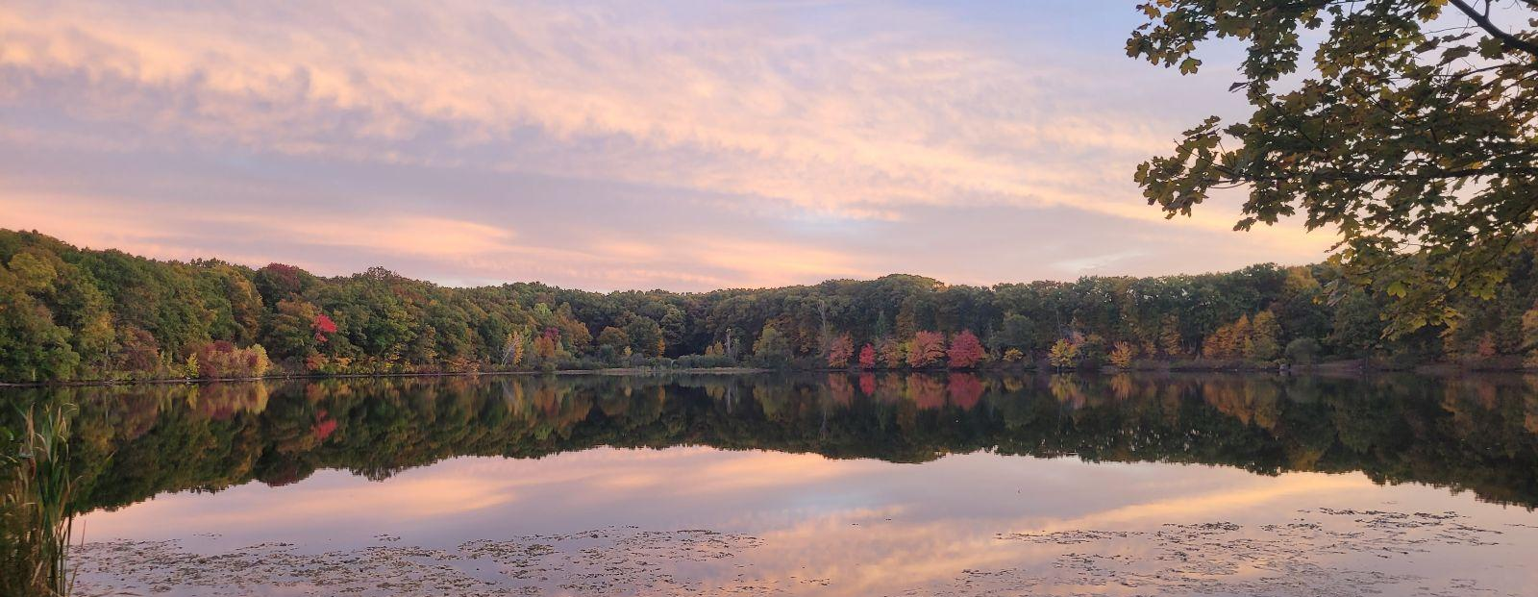
Activity
Visioning: Keep, Change, Add
Notes:
2016 Community Vision Feedback Activity
Large poster board; Miro board on the screen; each MPSC member should have a paper with the Vision Activity as well

Slide 20
Set a Vision for the Future
A master plan vision articulates where a community wants to be in about 10-20 years. It states what the Town, guided by the contents of the master plan, is working towards. Relative to the other parts of a master plan, a vision is the policy direction, the goals for each master plan element are the policy framework, and the implementation plan is the roadmap for making that vision a reality.
Notes:
What is a Vision?
A Vision for a comprehensive plan helps paint a mental picture of what residents want their community to look and feel like in the future.
A vision statement is aspirational in nature, and it is a target for what the Master Plan’s goals and actions aim toward.
A vision also helps set a policy direction for the plan by conveying community values, community strengths to lean on, and community challenges to work to address
Shrewsbury has a community vision from its 2016 Master Plan that we can build on for this 2026 update.

Slide 21
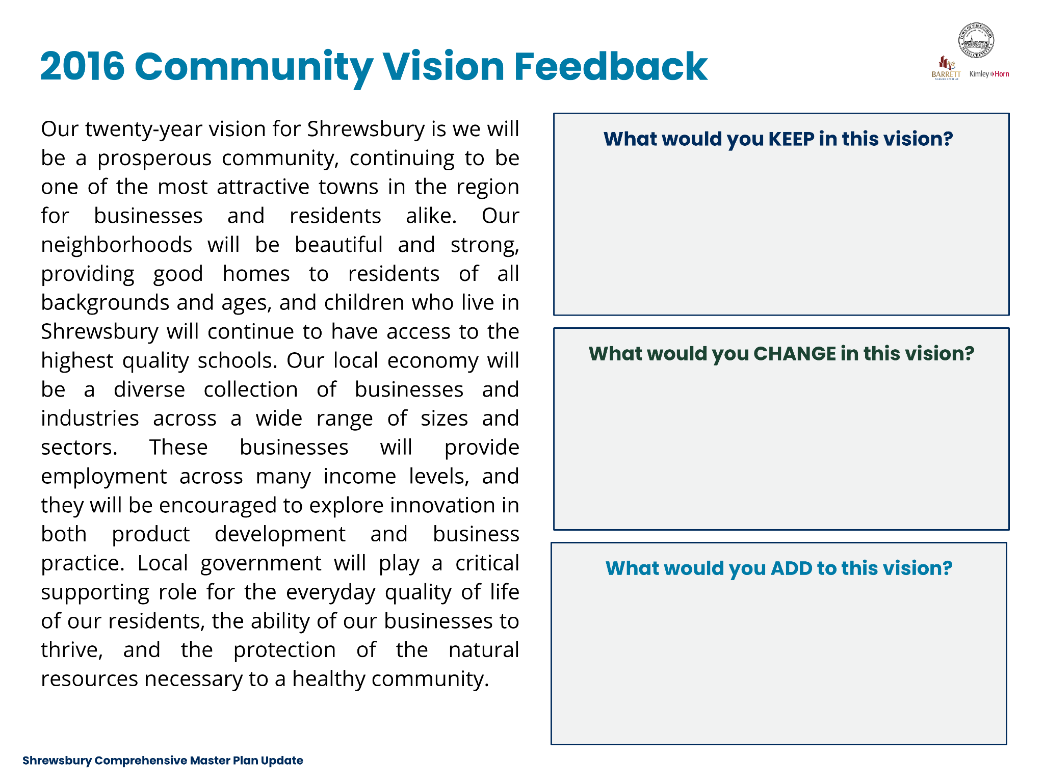
Notes:
Ask the MPSC Chair or someone else if they would like to volunteer to read the 2016 Vision out loud.

Slide 22
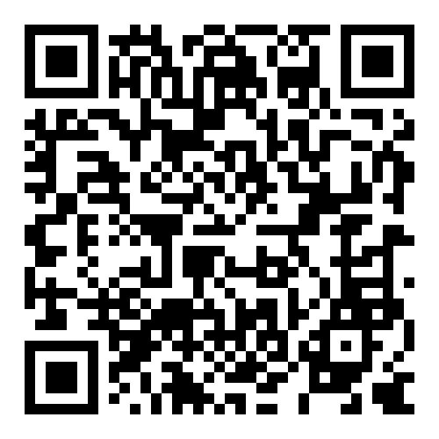
Closing Activity:
October Question of the Month
Tell us what you value about Shrewsbury and what you hope will remain part of the community as it grows and changes. This could be a place, a tradition, a service, a natural resource, a community quality, or something else that matters to you.
What makes Shrewsbury special today, and what should we protect for the future?
Scan the QR Code to answer the Question on the project webpage

Slide 23

Project Schedule
Getting Started
(May-Jun ’26)
Inventory and Assessment
(Jul-Sep ’26)
Key Issues & Opportunities
(Oct-Dec ’26)
Goals
(Jan-Feb ‘26)
Implementation Plan
(Mar-Apr ’27)
Final Plan
(May ’27)
Workshop #1: Discovery & Visioning
Workshop #3:
Advancing Goals to Strategies
Workshop #2:
Sharing Inventory Findings & Vision & Goals
* Dates shown are preliminary and may be revised as the master planning process progresses.

Slide 24
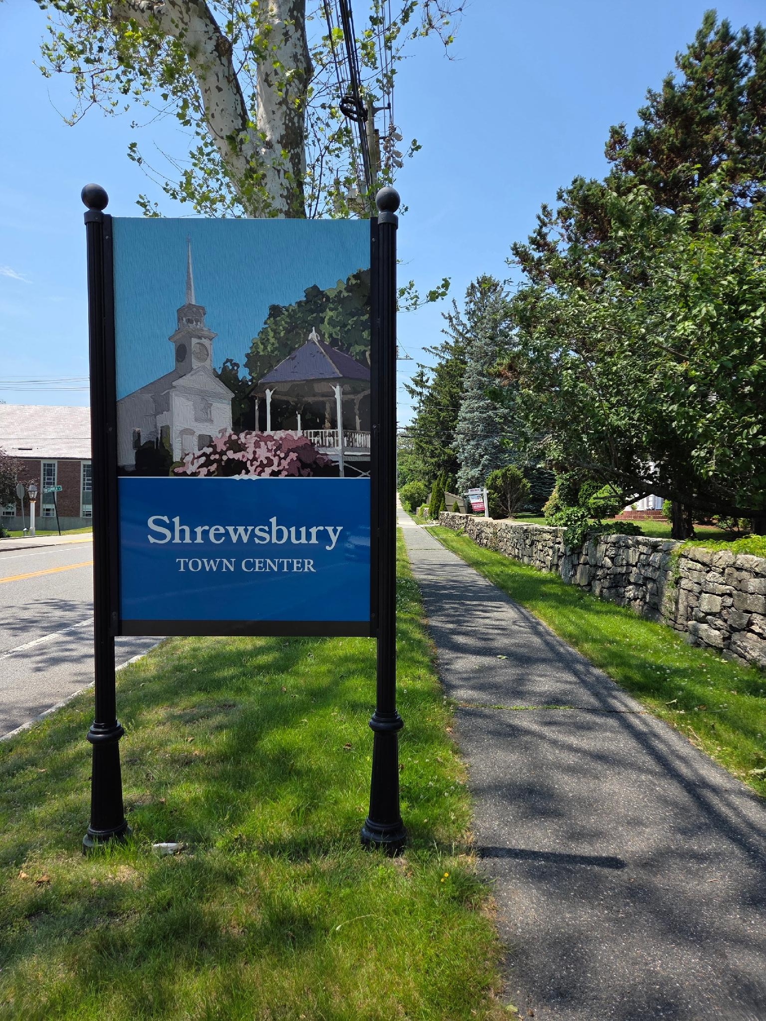
Set Next Meeting Date
November 12, 2026

